Slide 1
Automated Car Catalog System For Enhanced Showroom Management

Slide 2
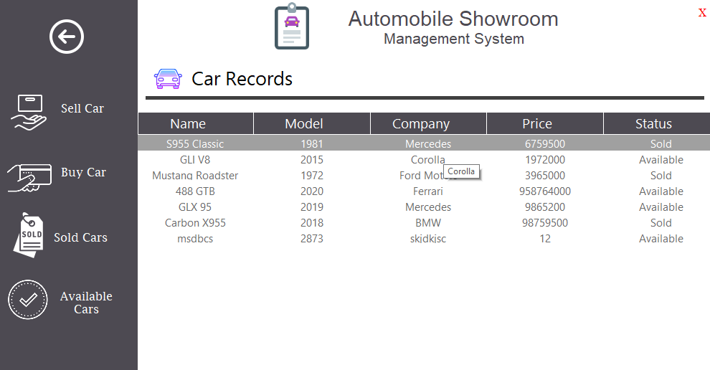
Introduction to Automated Car Catalog System
An automated car catalog system streamlines the management of vehicle inventories in showrooms.
It integrates digital tools to enhance efficiency and customer engagement.
The system aims to optimize showroom operations and improve overall customer experience.
Notes:
Image source: https://user-images.githubusercontent.com

Slide 3
Key Features of the System
Real-time inventory updates ensure accurate vehicle information at all times.
Interactive digital displays provide detailed vehicle specifications and images.
Search filters and sorting options enable quick access to desired vehicles.
Notes:
Image source: https://www.slidemake.com

Slide 4
Benefits for Showroom Management
Simplifies inventory tracking and reduces manual paperwork.
Enhances staff productivity by providing instant access to vehicle data.
Improves customer satisfaction through efficient and transparent service.
Notes:
Image source: https://www.slidemake.com

Slide 5
Technology Components
Cloud-based database stores comprehensive vehicle information securely.
User-friendly interface allows seamless navigation for staff and customers.
Integration with existing dealership management software enhances overall functionality.
Notes:
Image source: https://www.slidemake.com

Slide 6
Implementation Process
Conduct an initial assessment of the showroom’s current inventory management practices.
Customize the system to match specific showroom needs and branding.
Train staff thoroughly to ensure smooth adoption and effective usage.
Notes:
Image source: https://www.slidemake.com

Slide 7
Impact on Customer Experience
Customers can browse available vehicles digitally, reducing wait times.
Virtual tours and 360-degree views provide immersive vehicle exploration.
Enhanced transparency builds trust and encourages purchase decisions.
Notes:
Image source: https://www.slidemake.com

Slide 8

Data Analytics and Reporting
The system collects valuable data on customer preferences and browsing habits.
Generate detailed reports to inform marketing and inventory strategies.
Use insights to optimize stock levels based on demand patterns.
Notes:
Image source: https://www.scribbledata.io

Slide 9
Challenges and Solutions
Ensuring data security and protecting sensitive customer information.
Addressing resistance to change by providing comprehensive training.
Regular system updates and maintenance to ensure optimal performance.
Notes:
Image source: https://www.slidemake.com

Slide 10
Future Trends in Showroom Management
Integration of augmented reality (AR) for virtual vehicle customization.
AI-powered chatbots for instant customer support and inquiries.
Expansion of e-commerce capabilities for online vehicle purchases.
Notes:
Image source: https://www.slidemake.com

Slide 11

Conclusion and Next Steps
An automated car catalog system significantly enhances showroom efficiency and customer satisfaction.
Proper implementation and continuous updates are key to maximizing benefits.
Showrooms should consider adopting such systems to stay competitive in the automotive industry.
Notes:
Image source: https://phpgurukul.com

